Slide 1

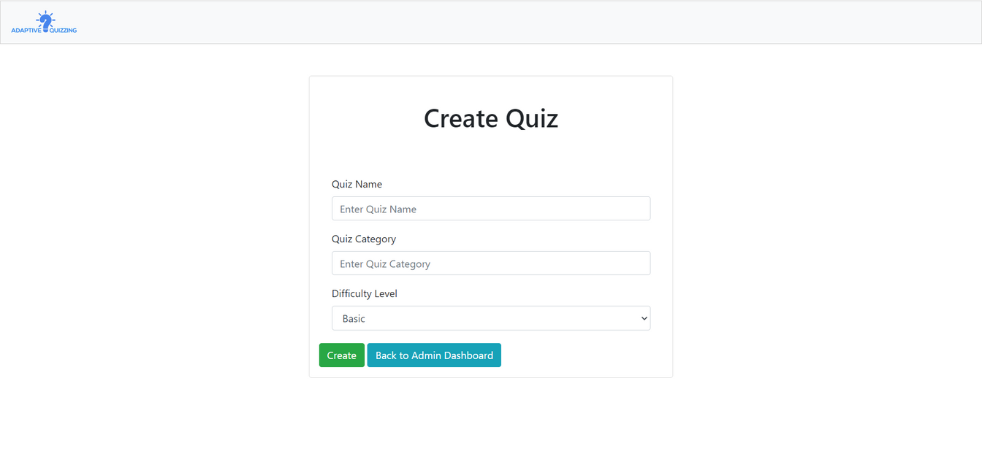

North Western University (NWU)
Welcome to
Adaptive Quizzing Platform
By: Israt Jahan (20222002010)
& Suraya Akter (20221063010)
Mentor By: M. Raihan
Assistant Professor, Dept. of CSE, NWU

Slide 2

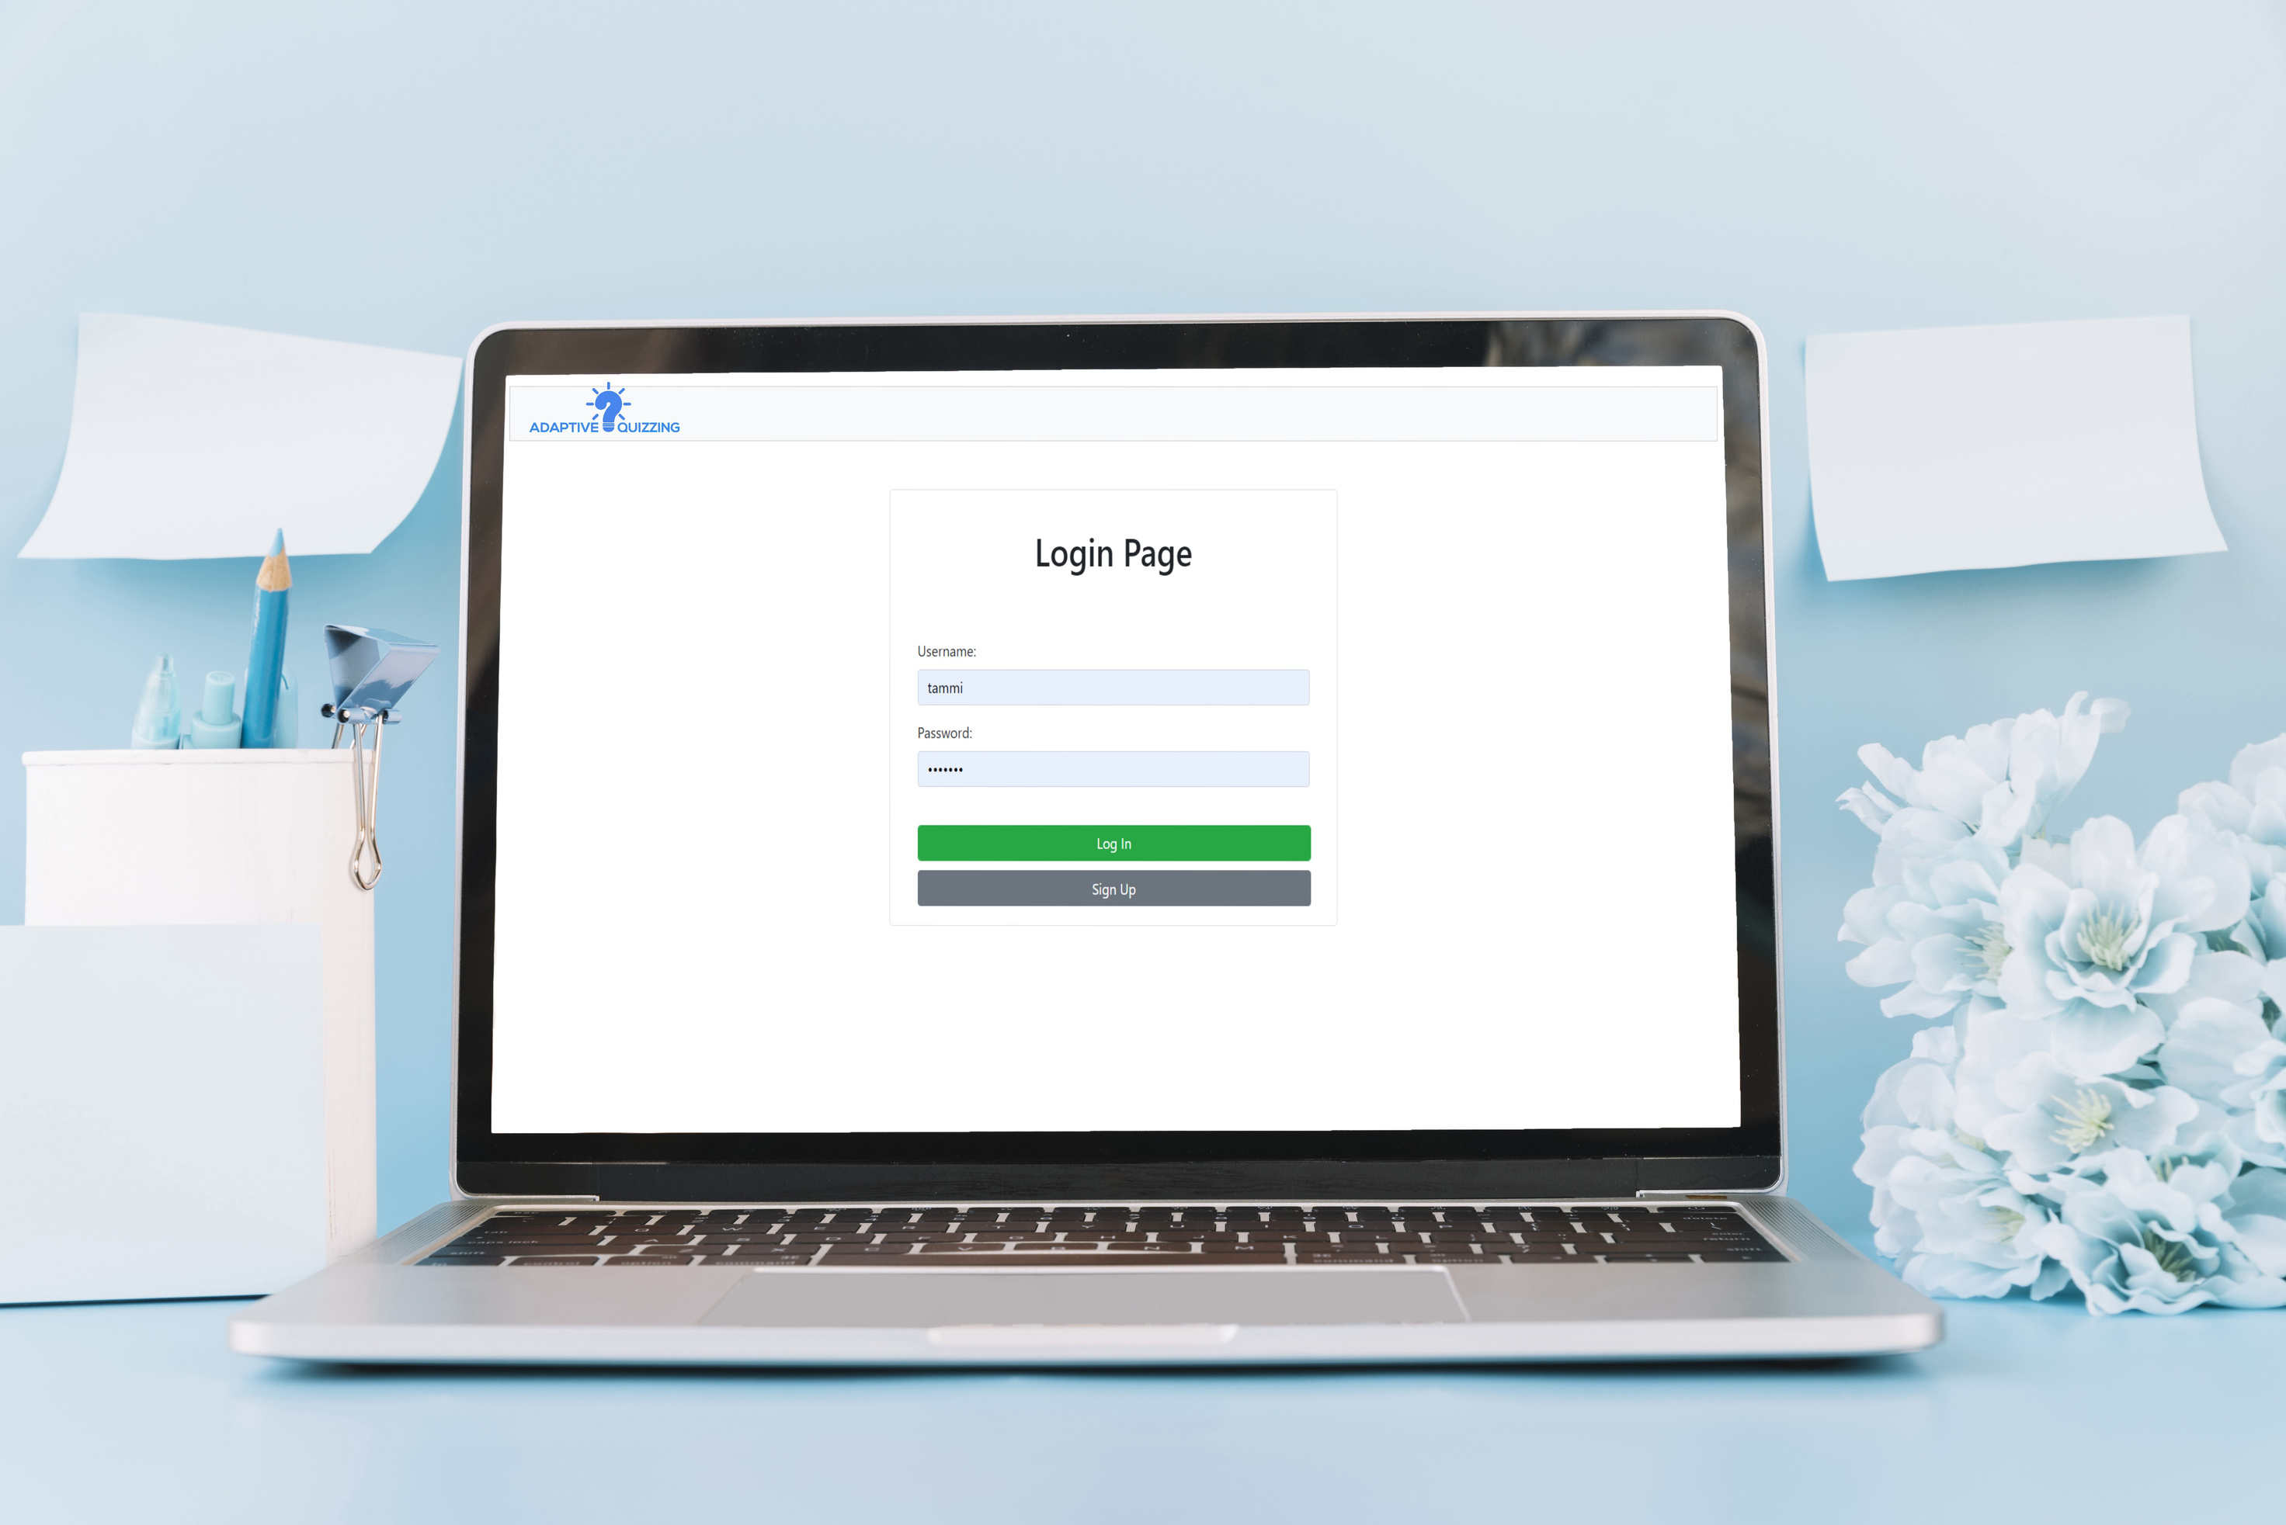

Overview
Introduction
01
Key Features
02
Problem Statement
03
Solution
04
Benefits
05
Business Model
06
Future Developments
07
Demo Time
08
Thank you
09

Slide 3

Introduction
Assalamu alaikum, Good [morning/afternoon/evening], ladies and gentlemen. Thank you for joining us today.
Let’s delve into the exciting world of adaptive quizzing and explore how it’s reshaping education.
Imagine a platform where educators can create customized quizzes, and students can engage in interactive learning experiences. That’s what our Adaptive Quizzing Platform is all about.

Slide 4
Key Features
Freemium Business Model:
We offer both free and paid features.
Educators can explore the basic functionalities without any cost.
Premium users unlock additional features for a more robust experience.
Customizable Quizzes:
Admins and teachers can tailor quizzes to their specific curriculum.
Set questions that align with learning objectives.
Automatic Topic-wise Quizzes:
Premium users gain access to pre-set quizzes organized by topics.
No more time wasted on quiz creation; students can focus on learning.
Integration of AI Services:
Our upcoming integration of ChatGPT API and Gemini API will revolutionize learning experiences.
Imagine an AI-powered tutor guiding students through quizzes and providing personalized insights.

Slide 5

Problem Statement
Education faces several challenges in today’s dynamic world. Traditional methods of teaching and assessment often fall short in meeting the diverse needs of students and educators. Here are some key problems:
One-Size-Fits-All Quizzes
Time-Consuming Quiz Creation
Lack of Real-Time Feedback
Educators struggle to create quizzes that cater to individual learning paces and styles.
Students find it frustrating when quizzes don’t align with their understanding of the material.
Teachers spend valuable time crafting quizzes from scratch.
This leaves less time for personalized interactions with students.
Students need immediate feedback to gauge their progress.
Waiting for manual grading delays the learning process.

Slide 6
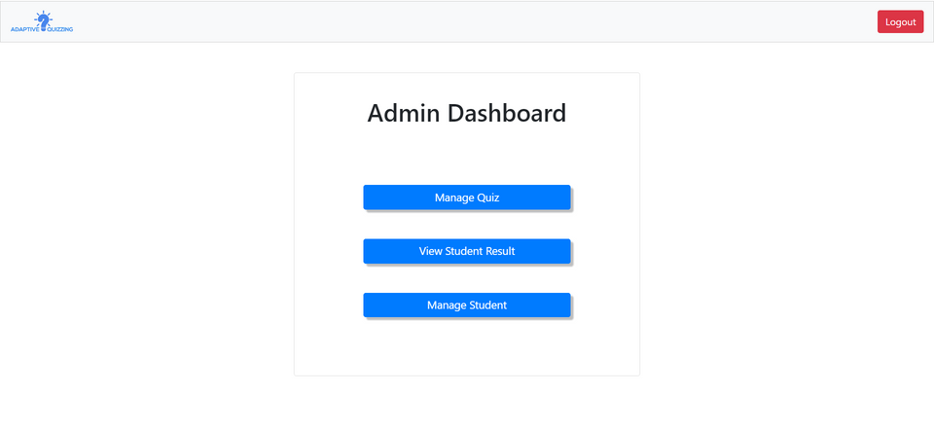

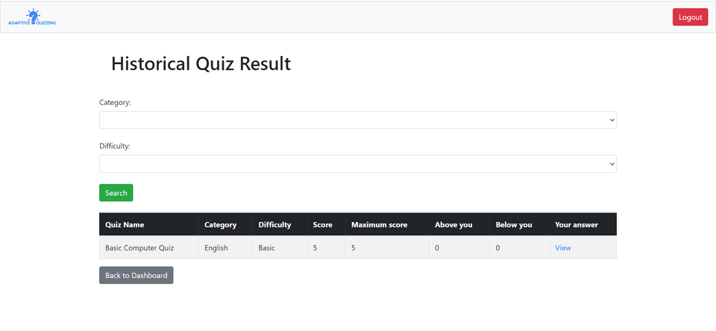
Solution: The Adaptive Quizzing Platform
Customization and Adaptability
Automatic Topic-wise Quizzes
Instant Feedback and Analytics
Educators can create customized quizzes tailored to their curriculum.
The platform adapts to different learning styles, ensuring a personalized experience for each student.
Premium users gain access to pre-set quizzes organized by topics.
No more time wasted on quiz creation; students can focus on learning.
Students receive real-time feedback after completing quizzes.
Educators have access to detailed analytics on student performance, allowing for targeted interventions.

Slide 7




Benefits
FOR EDUCATORS
FOR STUDENTS
Time-saving: Efficient quiz creation.
Analytics: Detailed insights into student performance.
Personalization: Tailored learning experiences.
Interactive Learning: Engage with quizzes dynamically.
Instant Feedback: Know where you stand.
Vast Repository: Access educational content across subjects.
EASY TO USE
ONLINE SUPPORT
.
Access Anywhere: Study on the go with our responsive web application.
Quick Setup: Create quizzes and track progress in just a few clicks.
24/7 Assistance: Reach out to our dedicated support team anytime, anywhere.
Live Chat: Connect with us instantly for real-time assistance.

Slide 8

Business Model
We operate on a Freemium Model:
Free access with essential features.
Premium subscription plans for advanced functionalities.
01
The Adaptive Quizzing Platform operates on a freemium business model, combining free and paid features to cater to educators and students. Here are the key aspects:
Our revenue streams:
Monthly or yearly subscription fees for premium features.
Potential income from AI integration services.
02

Slide 9



Future Developments
AI Integration:
Brace yourselves for intelligent learning experiences.
ChatGPT API and Gemini API will enhance our platform.
01
Expansion Plans:
We’re committed to growing our feature set.
Reaching a wider audience is our goal.
02

Slide 10
Demo Time

Slide 11

THANK YOU!

